Slide 1
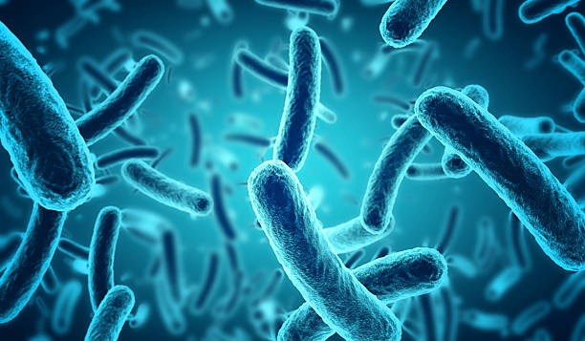

Investigating the effects of allometric scaling laws on microbial environments
Charly Bisson
Arizona State University

Slide 2
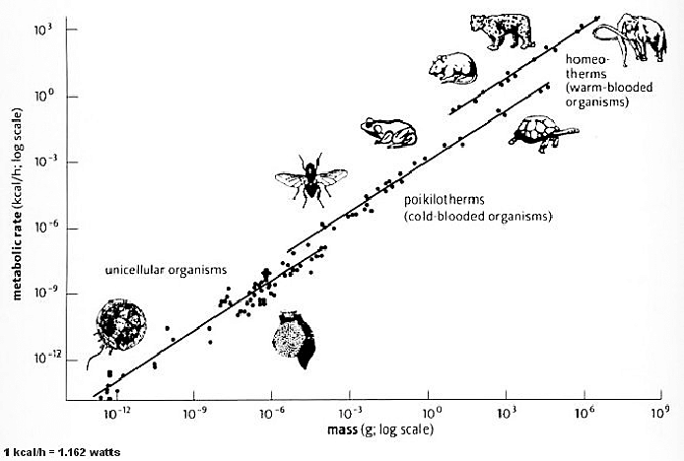
Allometric Scaling
(Hemmingsen 1960)

Slide 3
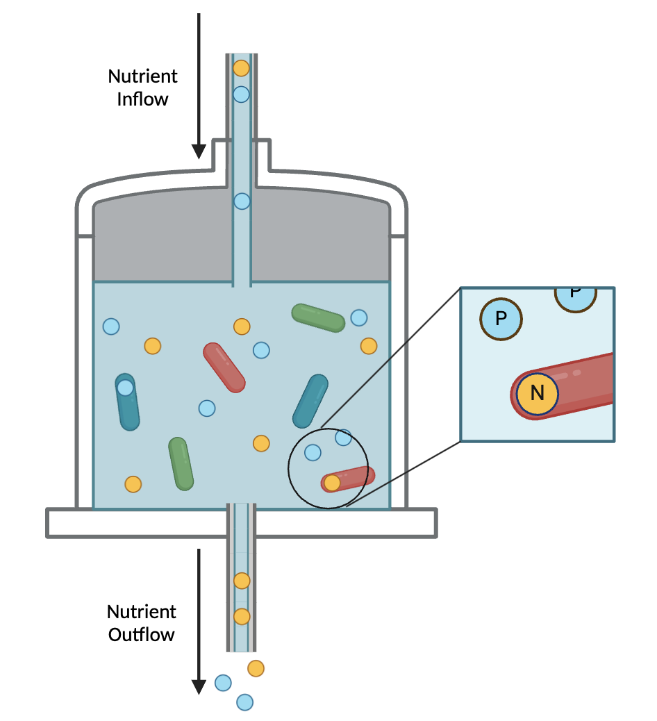
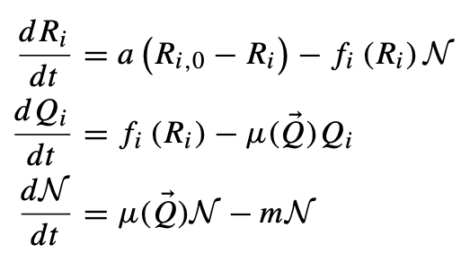
The Model

Slide 4
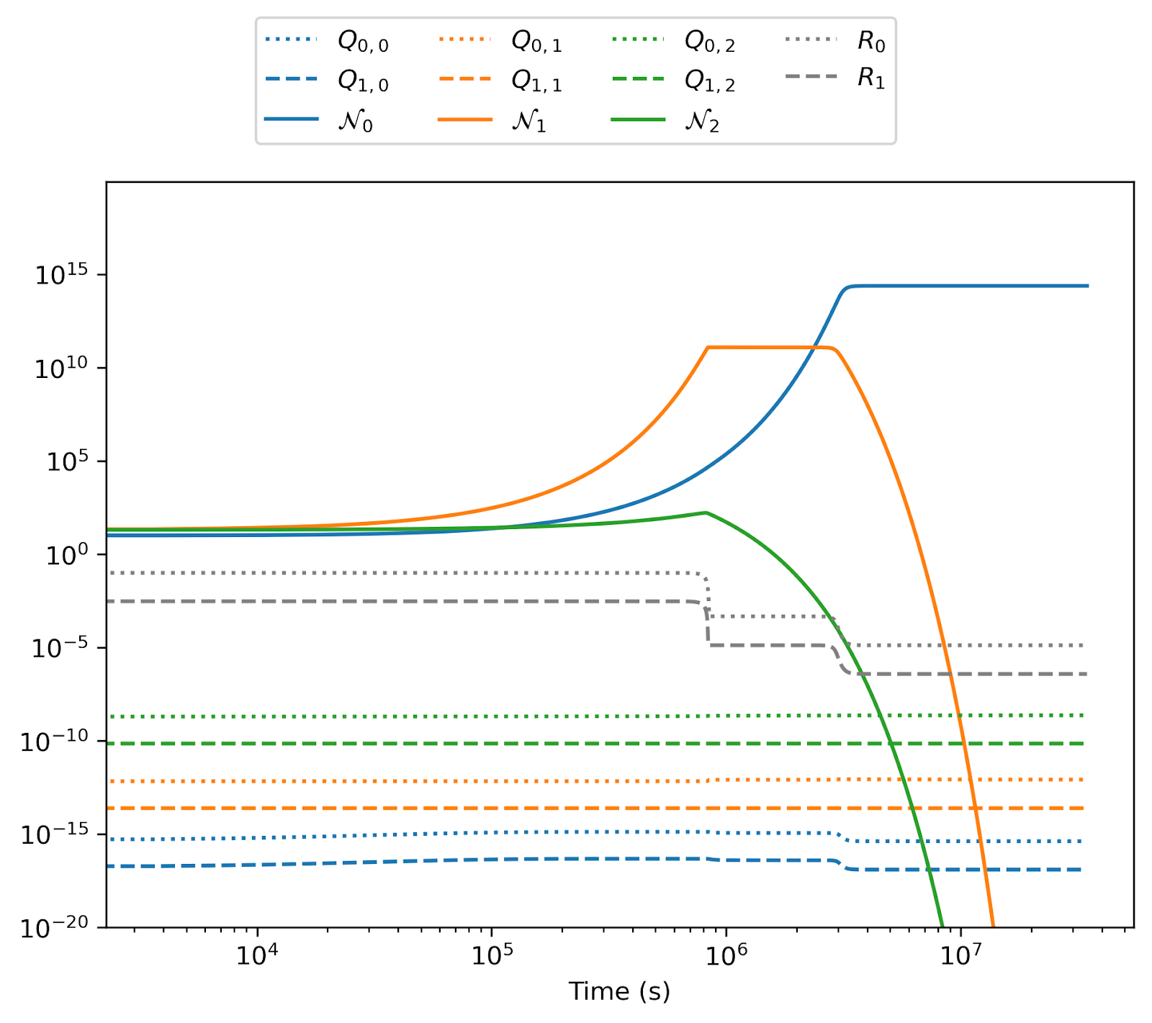
Preliminary Results

Slide 5
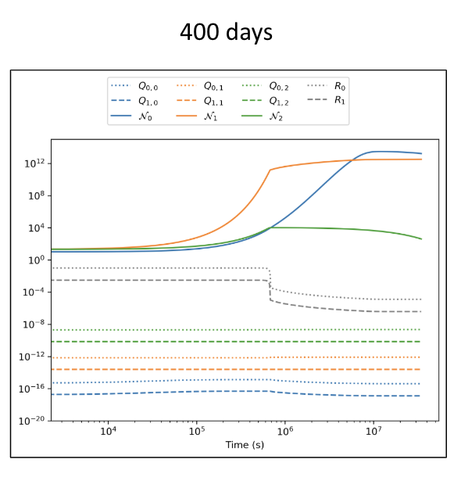
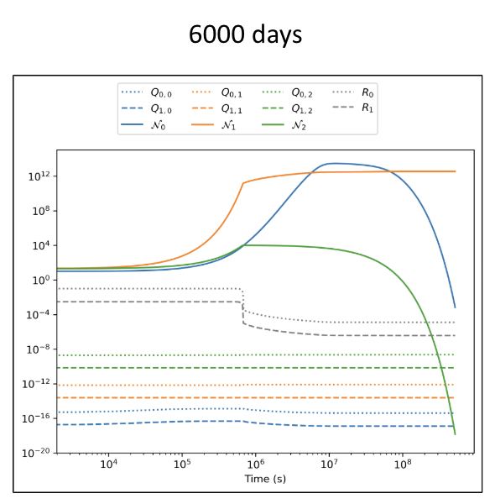
Mortality Rates (proportion of biomass lost/second)
Species 0 | Species 1 | Species 2
0.59 | 0.021 | 0.0089
Post-Modification

Slide 6
Results
Unstable coexistence
Smaller cell volume more likely to survive (species 0)

Slide 7
Next steps
Indefinite coexistence (find steady states)
Incorporate interspecies interactions

Slide 8
I’d like to thank Dr. Cole Mathis and Olivia Smith for their mentorship and support throughout this project, and to NASA Space Grant for the funding.
Questions?
References:
Klausmeier, C. A., E. Litchman, and Simon Asher Levin. "A model of flexible uptake of
two essential resources." Journal of theoretical biology 246, no. 2 (2007): 278-289.
Kempes, C.P., Follows, M.J., Smith, H. et al. Generalized Stoichiometry and
Biogeochemistry for Astrobiological Applications. Bull Math Biol 83, 73 (2021).

